Slide 1



JAIPUR ENGINEERING COLLEGE AND RESEARCH CENTRE
Year & Sem. – B. Tech II year, Sem.-III
Subject –Technical Communication
Unit – 4
Presented by – Sonia.K
Designation - Assistant Professor
Department - English and Humanities
1

Slide 2
VISION OF INSTITUTE
To become a renowned centre of outcome based learning, and work towards academic, professional, cultural and social enrichment of the lives of individuals and communities.
1

Slide 3
MISSION OF INSTITUTE
Focus on evaluation of learning outcomes and motivate students to inculcate research aptitude by project based learning.
Identify, based on informed perception of Indian, regional and global needs, the areas of focus and provide platform to gain knowledge and solutions.
Offer opportunities for interaction between academia and industry.
Develop human potential to its fullest extent so that intellectually capable and imaginatively gifted leaders may emerge.
1

Slide 4
Course Objective
CO1: able to express themselves better in technical writing by understanding the concept, style and methodology used in Technical communication.
CO2: able to pursue higher studies by working on all aspects of English Language and also develop a better understanding of process and design of technical texts.
CO3: able to get an in depth knowledge of technical communication used in professional life by getting to know all the forms and aspects of Technical Communication.

Slide 5
Jaipur Engineering College and Research Centre, Jaipur
Department of English & Humanities
IIYear - IIISemester:B.Tech.
Contents
Introduction to Technical Communication-
Definition &Aspects of TC
Forms of Tech. Comm.
Importance of Tech. Comm.
Tech. Comm. Skills
Style in Tech. Communication
2. Comprehension of Technical Texts and Information Design and development
Reading and Comprehending Instructions and Technical Manuals
Interpreting and Summarizing Technical Texts
Note Making
Information Collection, Factors affecting technical Documents
Strategies for design and writing for print and online media

Slide 6
Contd…
3. Technical Writing, Grammar and Editing
Technical writing process
Common errors
Editing strategies
Adv Tech. Comm.- Planning Drafting etc.
Email, Minutes of Meeting etc.
4.Advanced Technical Writing
Technical Reports- Types, Characteristics & Structure
Technical Proposals- Types, Characteristics & Structure
Technical Articles- Types, Characteristics & Structure

Slide 7
Unit 4.
Advanced Technical Writing
Technical Reports
A technical report (also scientific report) is a document that describes the process, progress, or results of technical or scientific report or the state of a technical or scientific research problem. It basically compiles the description about some process, it may be progress of some activity or an organisation or a scheme. The technical report should ensure all the components necessary in it and in proper sequence. If the target group needs some background to study the report, it should be covered. The information should be factual and purpose specific.

Slide 8
Characteristics of Technical reports ....
may contain data, design criteria, procedures, literature reviews, research history, detailed tables, illustrations/images, explanation of approaches that were unsuccessful.
may be published before the corresponding journal literature; may have more or different details than its subsequent journal article.
may contain less background information since the sponsor already knows it
may have restricted access
  classified and export controlled reports
may contain obscure acronyms and codes as part of identifying information

Slide 9
Characteristics of Technical reports in detail....
Shape and Size: The report may have 8-10 pages, typed or printed in proper format, with proper margin and spacing. The upper size of the report is related with time, efforts and resources. If necessary, trim it as per requirement.
Content: The reports should be easy to follow, for a non technical person or a non specialist. The necessary technical details may be covered but, over doze of technicality should be avoided.
Facts: As per the objective of the report and requirement of the target group of the agency assigning the job, the facts and figures should be covered. The necessary detailing of facts should not be sacrificed.

Slide 10
Contd…
Sources: The technical report is the compilation of information from various sources, like publication in journals and books, technical brochures, personal and written communication with experts, site visits, surveys, etc. The sources of information should be reliable.
Documentation: As mentioned, the information compiled in the report is collected from different sources. There is a tradition of acknowledging the sources as references or other modes. This transparency will be liked by the original writers. All the information, data, opinions should be well documented

Slide 11
Contd…
Target Readers: Some times, the report is prepared by a committee, appointed for the purpose. So, it is ought to be specific. In other cases, it is desirable that the report aims at some specific group, so that it can meet with the expectations of that group. Too general report may not be useful to any body.
Titles and subtitles: The report may cover different aspects of the work. They may be given some titles or headings. In case of a detailed report, under each title, there may be a lot of content. It may be further sub divided in to subtitles. The titles and subtitles, help the readers in discriminating one topic or an aspect from the other and one subtopic from the other. On the writer side, it helps in proper organisation of the report, with proper focusing and on user side it helps in proper understanding of the report. If somebody is interested in a specific aspect of the report, he can refer accordingly.

Slide 12
Contd…
Physical Arrangement: The physical presentation of the report is concerned with typing and printing. The graphical or pictorial information may not be reproduced properly in computer or machine printing. Photo copying or scanning is advisable. A loose report or a strip binding or a spiral binding is not impressive and durable. Hard paper binding is advisable.
Graphics: In addition to description in alphanumeric form, the reports may have graphs, line diagrams, photographs, histograms, tables, pie charts, bar charts, line graphs, flow charts, block diagrams, etc. Graphics makes the report to be followed easily, more illustrative and authentic. It is an art to make the report impressive, by using graphics.

Slide 13
Types of Technical Reports
Only some forms of technical reports are highlighted here. Depending on the nature of activity, there can be many more types.
1) Technical background report
This type of report is a technical description, to give some background of topics like wind power, environment protection, VLSI technology, etc. The other technical writings may be for the general understanding of students, teachers or a common public. Here, the target audience is not specific. Technical background report is usually meant for a specific group. While inviting proposals for hospitals, engineering institutes, technical survey, etc. the government, semi government and private organisations may give some background about the requirement

Slide 14
Contd…
2) Instructions Report:
When the students perform the laboratory experiments, to record the procedure, they describe it in the instruction form. For uniformity, teachers also, prepare standard instruction manual for the students. It may be typed and given in advance, so that the students can perform the practical systematically. It covers objective or aim of the experiment, instruments required to carry out the experiment, some theoretical concept necessary, procedure of actual experiment including some precautions necessary for the safety of the instruments and users.

Slide 15
Contd…
3) Feasibility Study Report:
When a new product is to be developed or a new technology is to be adopted for the existing product, or a model is to be changed or a new manufacturing process is proposed, feasibility study is necessary. Some experimentation may be done on the prototype, alternative technologies may be studied, various procedures may be analysed and different revisions of models are tried After experimentation, analysis, study or survey the final outcome is expected. The report may justify or otherwise, the new product, technology, procedure, model or technique. The justification may be based on the state of art technology and its awareness, available or trainable manpower, availability of equipment and material, infrastructure, resources, etc.

Slide 16
Contd…
4) Recommendation report:
When a government, semi government or a private organization, gets number of offers from different persons or agencies or organisations for a specific work, the offers are critically reviewed by the expert committee. The parties may be given the opportunity of presentation and demonstration. After this exercise the committee prepares and submits a report, to accept a particular product, procedure, technology, option or offer by a particular party. The decision may be based on the capability of the proposer and financial considerations. In a purchase committee recommendation, negotiations and discounts are also helpful.

Slide 17
Contd…
5) Evaluation Report:
Report of the evaluation committee helps the management in taking the decision. Similarly, for a syllabus revision, assessment scheme, result analysis, ragging, student discipline, proposal for new courses, etc. issues committee may be formed and may give report.

Slide 18
Contd…
6) Primary Research Report:
It may not be related to some original work. Some experimentation may be done in house or some external facility may be used for the experimentation, some supporting survey may be carried out. The experimentation and survey work generates some data, which is analysed to draw conclusion. The report may cover the experimentation, equipments, hardware, software, infrastructure, background of the problem and final outcome of the research.

Slide 19
Contd…
7) Technical specifications:
While marketing the product, two types of manuals are used. Commercial manual describes the general details and cost aspect. The technical manual covers the detailed specifications of the product. It covers construction, materials, dimensions, size, weight, functions, operational features and special features. It may also, cover the market potential. A lot of alphanumeric data, tables, graphs, pictures are involved here. The stress is not laid on the quality of language but, facts and figures, highlighting the quality and performance characteristics of the product. It is aimed at convincing the consumer. For smaller consumer goods, the presentation style may be simple. For major items, with high costing, the target readers may be purchase officers or marketing managers. Some better style of presentation is preferable.

Slide 20
Contd…
8) Report Length Proposal:
Some proposal report may be the result of years of work. Large number of people may be involved in the study and analysis. The population of samples may also, be very large. Such reports are published in a book form, by many government and semi government agencies. Many private industries and organisations can use such reports for their activities. In addition to some common features, it may include feasibility study, literature survey, qualifications of investigators, and other persons involved in the process. Sometimes, this type of report may be the compilation of many other reports. The scope of the report is very wide. Large many details are covered here.

Slide 21
Contd…
9) Business Prospectus:
To start a new business or to expand or diversify the existing business, the businessman or an entrepreneur requires support of other people.
The businessman or an entrepreneur has to prepare the blue print of his business plan. The business activity should be described at length, the market potential should be identified, the capacity of other manufacturers or businessmen should be reviewed, the import and export problems should be covered, and total plan of full fledged activity should be developed. The requirement of manpower, infrastructure, etc. should be studied and reported. In some cases, phase wise plan for five or ten years may be proposed. Initially profitability may not be there. By future projection, the breakeven point and state of profitability should be forecasted.

Slide 22
Contd…
The technical reports can also be classified as following types, based on the objective.
Progress reports
Trip reports
Equipment evaluation reports
Laboratory report
Summary report
Data Archival report
A technical activity report
Inspection report
Investigation report

Slide 23
Structure and format of Reports:
Shape: The reports may be typed or printed. The report may be in a bound form, if it is to be submitted outside.
Cover page: Depending on the number of pages spiral binding, strip binding or hard paper binding is used. Standard A4 size, unlined, white plain papers are used. Hand written report is discouraged. The report usually starts with a cover page or the title page. The cover page covers title of the report, the name of agency or individual or group submitting the report, with complete address and contact details. It should also indicate the agency to which it is submitted.

Slide 24
Contd…
Summary: After the cover page, the successive page(s) may cover the summary of the report. It gives some idea about the purpose and scope of the report.
Index: The index or table of contents, with page wise references is desirable. It gives clear cut idea, about the details covered in the report. If the report is very lengthy, just like a book, the index helps in referring particular part of the report. If somebody is interested in the particular process or procedure, it can be referred on specified pages.

Slide 25
Contd…
Introduction:
The main part of the report follows the introduction. If the report is about some research or experimentation, it is necessary to explain the actual problem. What is the actual problem for the research or investigation that should be specified in the introduction, it defines the scope of the research or the investigation. How the research was carried out or what was the nature of investigation or experimentation that is specified here. Thus, it defines the background, which specifies technological, economical, social, political, legal condition under which the research or investigation was necessary .

Slide 26
Contd…
Main body or Core: The main body or core of the report is covered here. It first tries to identify the problem. How the problem was originated and what are the actual symptoms of the problem? This part basically deals with tools and techniques. In case of a software based problem, algorithms and flow charts may be covered. In electronics, waveforms are recorded.
Results: In technical and scientific research, based on investigations, results are derived. The results are usually presented as observation tables giving a lot of alphanumeric data. The results are tabulated. Using the observations, some graphs and histograms are developed. The errors, means and standard deviations are found.

Slide 27
Contd…
Conclusion:
After getting the results, a lot of statistical analysis is done. To derive fruitful conclusion, large number of proper samples are taken under proper condition. If the condition is not proper, if the sample size is less and if the samples are not proper, the process may give wrong conclusion.
Recommendation:
After completion of the research or the investigation, the results are analysed. There is some conclusion of the work. Using the conclusion, recommendations are made for the future course of action. If the research is for a new process, procedure or material, with encouraging results the new process, procedure or material is recommended for routine practice.

Slide 28
Contd…
References & Bibliography:
For any research work, a lot of papers published in journals and presented in conferences are available. It is an art to scan large number of references and select the relevant references.
Appendices:
While writing the report, the researcher or the investigator has a lot of material. He tries to arrange the material in a logical sequence. The flow and content should be such that one can easily read and follow the report. In this process some information, particularly factual data, is necessary to make the report authentic. If all the information is covered in the main body, the flow is not smooth. Such data is usually covered at the end, as appendices.

Slide 29
2) Technical Proposal
Document that lists and defines the technical requirements of a contract or project, and explains the approach and plan formulated to address them.
or
A technical proposal is a written official document to carry out some activity, with specified conditions on either side, with some financial consideration. It is a written/printed document, indicating their interest in providing the service, with specified conditions; procure material or equipment of given specifications; develop software for required application with given constrain; construct a building, road, bridge, railway line/station, dam, power house of given specifications; carry out research on a given problem or to solve some problem. The proposal also indicates financial expectations and other conditions like payment terms and time frame or schedule of completing the assignment.

Slide 30
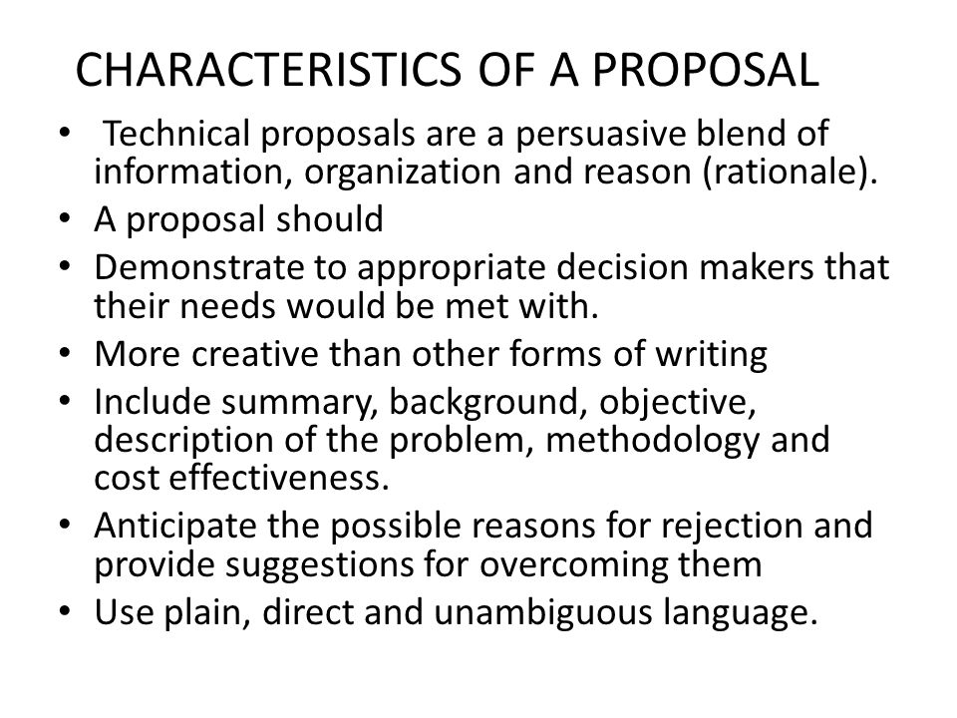
Characteristics of technical proposal

Slide 31
Types of Proposals:
Business Proposals:
Supply of material, construction of roads, buildings, railway, a garden, a bridge, a dam, a party plot, a parking lot, etc; providing services for transportation, washing, catering, safety, security, insurance, fire fighting, training, consultation, recruitment, maintenance, etc; procurement of equipment, hardware, software, stationary, etc: all these can be considered as business proposals.

Slide 32
Research Proposals:
Research proposals may be invited internally or externally. Government and public undertakings, private organizations, and educational institutes encourage the research activities. For the technological growth of the nation and survival of the industries in global competition, research is inevitable. There are certain funding agencies at national and international level for the research.

Slide 33
Contd…
From time to time, they invite research proposals on thrust areas and other areas decided by them. There are some government organizations, exclusively set up to carry out full time research, in specific area already identified or areas which may be identified in future.

Slide 34
Educational Proposals:
Education spans from playgroup, kindergarten, primary school, secondary school, higher secondary school; under graduate colleges of various faculties like arts, commerce, science, law, pharmacy, engineering; post graduate institute and institutes offering Ph.D. programmes in various faculties and various branches in case of engineering. At lower, school level, local authority may be involved.

Slide 35
Contd…
In all the cases, proposals are to be submitted to the competent authority, to initially start the institute with specified intake and later on to continue to run the institute. For schools and colleges, not offering professional courses, usually proposals are not invited. A particular trust or a body plans to start a school or a college. It prepares the proposal in a specified format and approaches the concerned authority. Here, as the proposals are not invited by advertisement or common circular or general announcement, the number of proposers may be less. There is not much competition of other proposers. The assessment is on individual basis, depending on the fulfillment of requirements and bonafide intentions of the trust. There may be indirect competition of other institutes in the area. So, the proposer should be aware about the availability and demand of seats, absorption to further studies or employment, available quality of education in the area, target group of students, transport and other infrastructure facility.

Slide 36
Accreditation Proposals:
There is a national board accreditation for the accreditation of programmes offered by engineering institutes. Accreditation is programme wise, for the strengths and weaknesses, as per specified format. The detailed criterion cover teaching learning aspects, management aspects, administrative aspects and financial aspects. The information covers student intake, admission process, result, recruitment, student feedback, teacher feedback, employer feedback, etc. The visiting team interacts with the students, the faculty, the supporting staff, the management, the administration, the guardians and the employers, too. Similarly, for Institutes and Universities, there is NAAC accreditation. These accreditations are not mandatory but, are useful for the institute or university to find its strengths and weaknesses and get third party assessment.

Slide 37
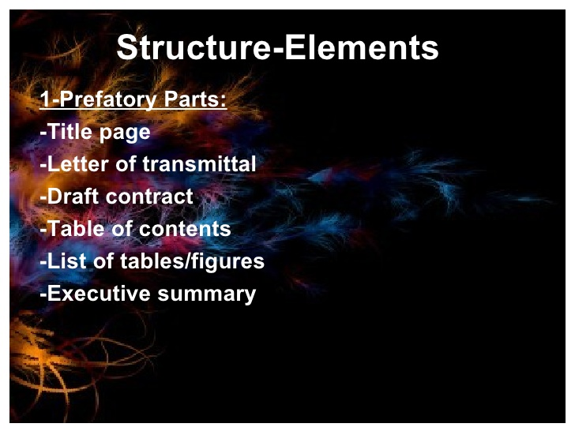
Structure and format of technical proposal

Slide 38
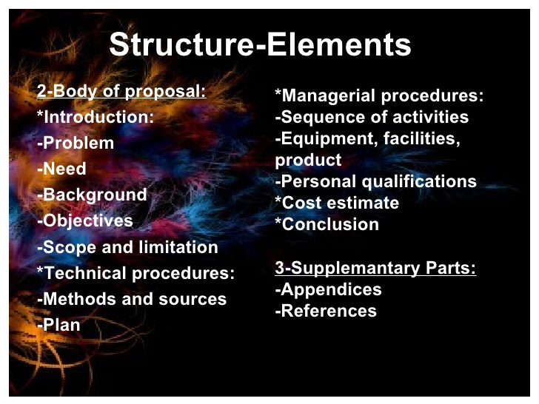
Contd…

Slide 39
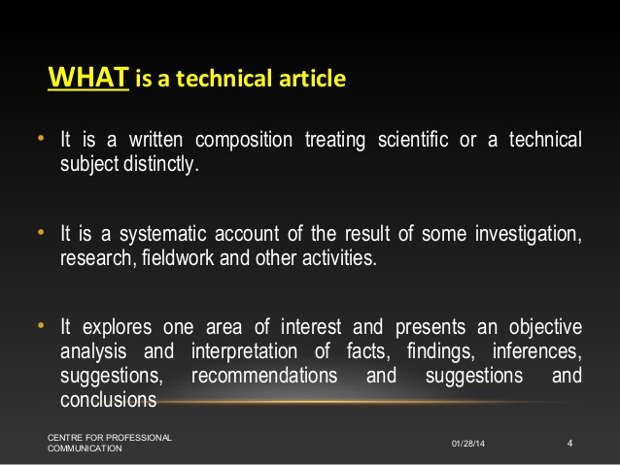
Technical Article

Slide 40
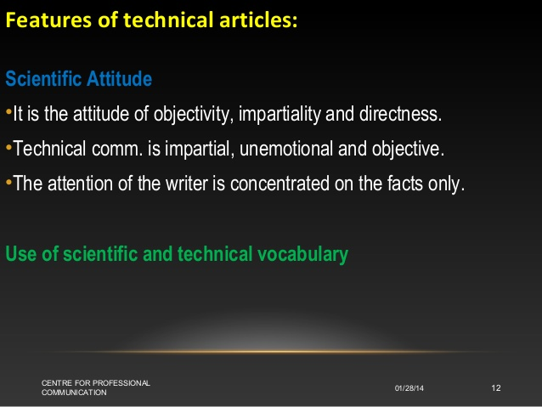
Characteristics of Technical Articles

Slide 41
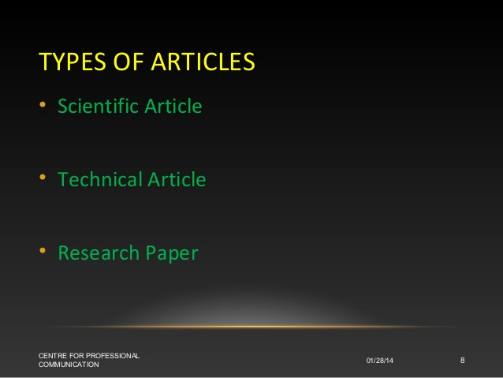
Types of Articles

Slide 42
Scientific Article
A scientific article is a publication that is based on empirical evidence. It can support a hypothesis with original research, describe existing research or comment on current trends in a specific field.

Slide 43
Research Paper
A research paper is an essay in which you explain what you have learned after exploring your topic in depth. In a research paper, you include information from sources such as books, articles, interviews, and Internet sites. You also use your own ideas, knowledge, and opinions.

Slide 44
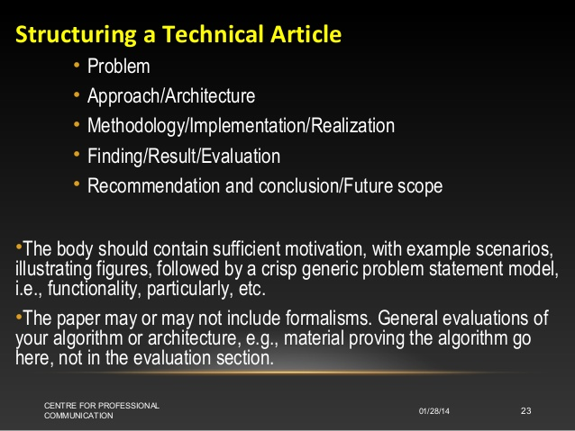
Structure of Technical Article

Slide 45
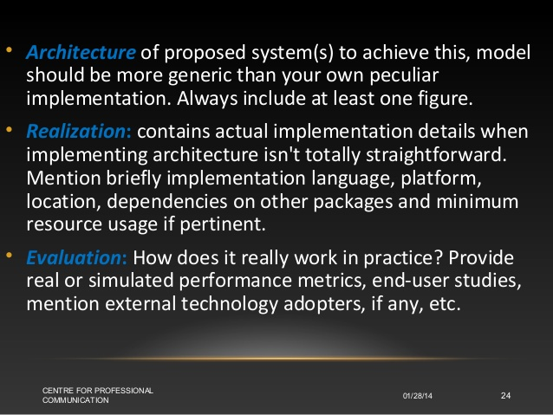
Contd…

Slide 46
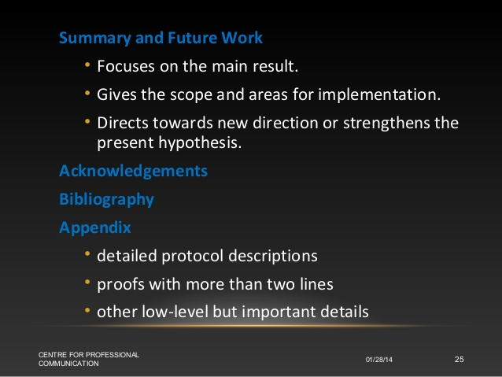
Contd…

Slide 47
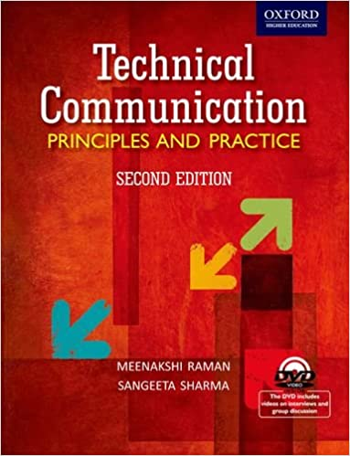


REFERENCES/BIBLOGRAPHY

Slide 48

Thank You!
Any questions?

